Slide 1

Government Grants and Contracts:
Getting Reimbursement for Your Nonprofit's Indirect Costs
Uniform Administrative Requirements, Cost Principles, and Audit Requirements for Federal Awards
Beth Bowsky, National Council of Nonprofits
David L. Thompson, National Council of Nonprofits
West Virginia Nonprofit Association| February 24, 2015
© 2015 National Council of Nonprofits
www.councilofnonprofits.org | @NatlCouncilNPs

Slide 2


Beth Bowsky
Policy Specialist, Government-Nonprofit Contracting, National Council of Nonprofits
David L. Thompson
Vice President of Public Policy, National Council of Nonprofits

Slide 3
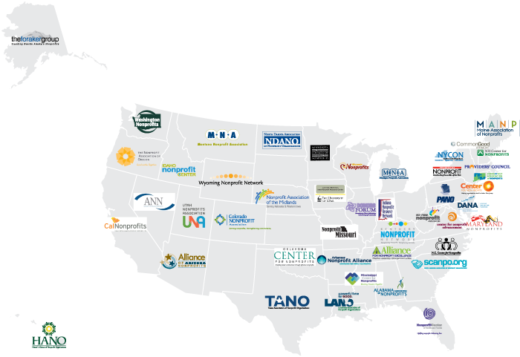


Slide 4

Connect with the
National Council of Nonprofits
Through West Virginia Nonprofit Association
On Twitter @NatlCouncilNPs and @buildnpcapacity
By signing up for Nonprofit Advocacy Matters and Nonprofit Knowledge Matters at www.councilofnonprofits.org/connect

Slide 5

The New OMB Uniform Guidance
The BIG Deal
How We Got Here
Key Changes in the OMB Uniform Guidance
How You Can Prepare for Implementation
What You Can Do to Ensure the Promise Becomes Reality

Slide 6

(So, What’s) The Big Deal?
OMB Uniform Guidance
Notes:
So, what is the big deal?
Ask: Britton (or James) Why did you think it important enough to have a webinar on it?
Ask: David, why do you think it is such a big deal?
For me this is a big deal because for the first time, state and local governments are going to be required to pay nonprofits for their indirect costs. This is especially important in PA when you look at the most recent Urban Institute Report that says more than half of nonprofits who responded to the survey said that governments limit the overhead they pay, and of those, 83% said they receive 10% or less—which is likely why 35% of PA nonprofits reported ending 2012 with a deficit. This is an opportunity to recover more of your costs to start turning this number around.
Turn back over to David to talk about how this came about

Slide 7

How We Got Here
A Happy Advocacy Story
An Advocacy Saga – with a Happy Middle

Slide 8
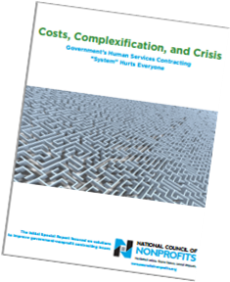
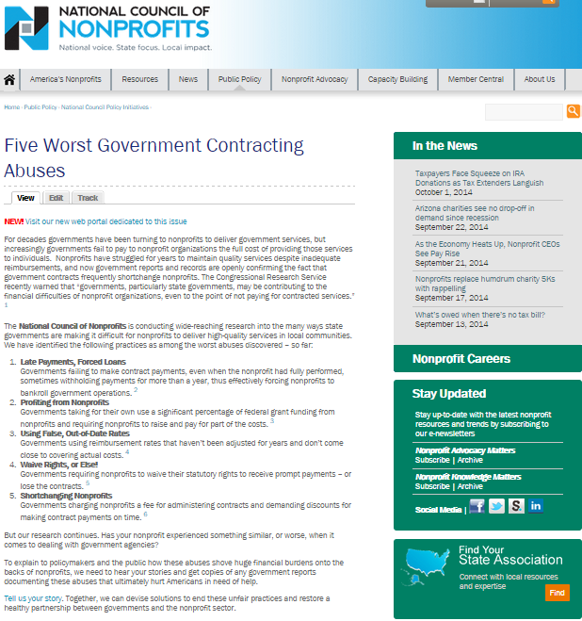
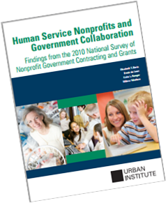

How We Got Here
Government-Nonprofit Contracting Work
2008 - Recession, late payments, opportunity for reform
2009-2011 – Research, scope of the problems, solutions, implementation
  Abuses identified
  Recurring problems
  Solutions
Notes:
David

Slide 9


How We Got Here
Government-Nonprofit Contracting Work
2012-2013 – OMB Draft Grants Reform
  Purpose: Streamline, reduce burdens, increase accountability
  Nonprofits Left Out: Main focus was governments and higher education
  Advocacy Campaign: Conference calls, webinars, surveys/polls, comments
    GAO, State Associations, national nonprofits
    National Task Force
  OMB Listened: Uniform Guidance 12/26/2013
Notes:
David

Slide 10
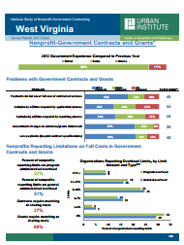

How We Got Here
Government-Nonprofit Contracting Work
2014 – OMB Uniform Guidance
  Effective 12/26/2014 (agencies revise regs)
  Outreach Efforts – information and “clarity”
    Federal webcast
    Oct. 2 Webcast – a “discussion”
    Frequently Asked Questions
2014 – New Data and Solutions
Notes:
David

Slide 11

REFORMS & IMPLEMENTATION
Administrative Reforms (A-110)
  Acronyms and Definitions
  General Provisions
  Pre-Award Requirements and Contents
  Post-Award Requirements for Financial and Program Management
  Cost Principle Reforms (A-122)
  Allowable and Unallowable Costs
  Indirect Cost Reimbursement
  Direct and Indirect Costs
  Procurement Requirements
    Audit Reforms (A-133)
  New Threshold
  Additional Government Audits and Internal Controls
  New Roles and Approaches
Notes:
So, the OMB Uniform Guidance—also referred to as the SuperCircular or OmniCircular or Grants Reform—is broken down into these three sections that we will provide a brief overview of, with a focus on the Cost Principles.
For those that are familiar with the previous circulars, you can see on the slide how the new sections relate. And, in fact, may not have even changed in some cases.
We’ll go through each of these broader sections and highlight the key changes, but keep in mind the need to look specifically at agency rules too.
The only thing we are not going to cover today, but I do want to mention is that there is a new requirement for all nonprofits using federal funds that when making purchases with those funds, you will need to follow the federal rules and regulations on purchasing. However, OMB heard the concerns from nonprofits about this and is now allowing nonprofits a one year grace period to implement this.

Slide 12
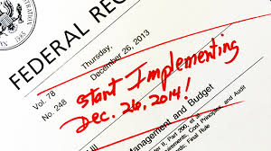
APPLICABILITY
Key Dates and Timing
Who This Applies To
Types of Awards and Subawards Impacted
Funding Streams Included
Notes:
The UG went into effect on December 26, 2013 and is to be implemented beginning December 26, 2014 for awards made after that date. So, if you are preparing applications now that will likely begin after December 26, you will want to keep the new requirements in mind—including the ability to get indirect costs reimbursed.
The clock starts at the beginning of your next fiscal year after December 26, 2014 for changes to the Single Audit, meaning it will affect your audit for 2015
There will be some additions to the Guidance on December 26 which will probably be to add some specificity to the procedures which be open for comment, even though they will be in effect as well. We don’t expect anything major, but you’ll want to make sure you are aware of any changes.
In terms of what is covered,
All nonprofits receiving federal funds, either directly or more likely indirectly. Often included in state and local grants and contracts.
Applies to grants, cost reimbursement and fixed price contracts and subcontracts—which would include POS agreements, or agreements where you are paid a per diem or some other per unit amount.
the Guidance applies primarily to discretionary funds. Several block grants and entitlement funds are excluded from most of the guidance (except the audit requirements). There is a list in the Guidance Document of the specifics—IV-E, Community Service, Social Services, Mental Health Block grant (awards that are part of the Omnibus Budget Reconciliation Act of 1981 ) are excluded. But, and here is the important part, the Guidance applies regardless of whether you receive funds directly from the federal government or as a subrecipient through a pass-through like the state or local government (or even another nonprofit).

Slide 13
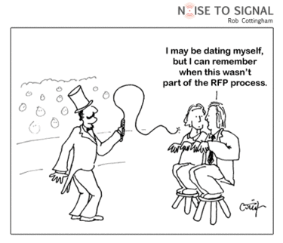
PRE-AWARD REQUIREMENTS 200.1XX
Requirements for Federal Agencies
  Award Posting
  RFP Content
  Standard Application
  Merit Review
  Risk Assessments
Notes:
We can go through these quickly and can provide you additional details after this webinar if you want, but for now just wanted to make you aware of some of the changes. The Pre-Award Requirements actually are instructions to the federal government, so are more about what you can expect from them as part of the changes being implemented.
Recommended at least 60 day posting, but a minimum posting of awards for 30 days
Specific and consistent information that must be provided to you in an RFP
Standardization of Application requirements
A selection process based on merit
And, governments and other pass-throughs will now need to conduct risk assessments before finalizing a grant with a nonprofit and then base reporting and monitoring requirements on the results of that assessment.

Slide 14

POST AWARD: PASS-THROUGH ENTITY REQUIREMENTS
Single Audits
Provide Subawardee Information
Perform Risk Assessment for Subrecipient Monitoring
Verify Audit Compliance
Report in Accordance with FFATA
Pay Subrecipient Indirect Cost Rate
Notes:
For Post Awards—
The new threshold for needing to get a Single Audit (previously often referred to as an A-133 audit) is increased from $500,000 to $750,000.
As a subawardee, the government is required to provide you will some specific information, including the sources of funding they are using so that you know whether or not you reach the threshold for a single audit.
Pass-throughs will now also have to conduct risk assessments of subrecipients as well as verify your audit compliance.
You will also be required to post your single audit on federal website in a machine readable format (FFATA=Federal Funding and Transparency Act (2006))
Last, but definitely not least, is that even as a subrecipient, the pass-through entity regardless of whether this is the state government, local government or another nonprofit, will be required to pay your indirect costs.

Slide 15
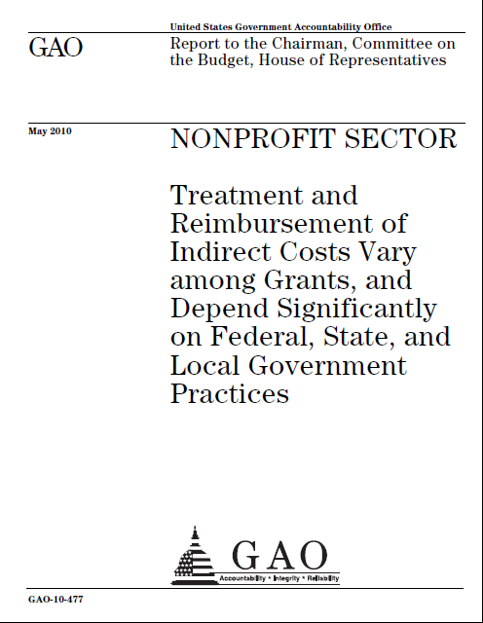
REQUIRED INDIRECT COST REIMBURSEMENT
With Federally Approved Negotiated Indirect Rate
All Federal Agencies
All Pass-through Entities
1 Four-Year Extension Option
Without Federally Approved Indirect Rate
10% of MTDC De Minimis (Indefinite Use) or
Negotiate a Rate Based on Federal Guidelines
Notes:
To give you a little more detail on the indirect cost reimbursement requirement:
If you have an approved federal indirect cost rate, everyone must pay this rate—other federal agencies, or any pass-through entity. And, if you want, you can request this rate to be extended for up to 4 years, but only once.
If you do not have an approved federal rate, then you can either negotiate a rate based on your actual costs or elect to use the de minimis rate which is 10% of your modified total direct costs.

Slide 16



DIRECT vs INDIRECT
Generalizations
  Direct: Easily attributable to a specific program
  Indirect: Organizational or shared across programs
Situational Determination
Changes in OMB Uniform Guidance
Notes:
In order to determine what your indirect rate is, you first need to figure out which costs are direct and indirect. This is not always as easy as it sounds because the same cost can be either depending upon several things. For example
Receptionist—Just answers phones—indirect
Does initial program intake—both direct and indirect
Building—all one program—direct
Multiple programs—indirect
Copier Used by all programs—indirect
Each program has counter to identify usage—direct
NEW—Program Managers as direct costs
Computing devices under $5,000 as supplies (usage will determine direct or indirect)

Slide 17
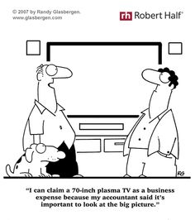
ALLOWABLE vs UNALLOWABLE
Allowable
  Reasonable
  Necessary
  Conforms with policies
  Treated consistently
  In accordance with GAAP
  Not used for cost share or match requirement
  Typical Unallowable Costs
    Fundraising
    Most Advertising and Public Relations
    Lobbying
    Entertainment, except program related
    Salaries above established caps
Notes:
Once you know which costs are direct and indirect, you will need to determine which costs are allowable or not allowable. This is where confusion happens because of the use and misuse of the terms administrative/overhead and indirect costs.
Administrative Costs do not make the distinction between allowable and unallowable. Used outside of government, it includes all of your indirect costs, including funding raising.
Governments use the term indirect which means only those costs that are shared and allowable.
As such admin/overhead will always be higher than indirect costs

Slide 18
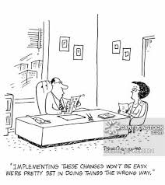
Notes:
Know what’s in the UG
Prepare Your Organization
It is important to recognize that change is difficult, even when it is for the good. It takes time, patience, and a lot of communications…How often do good plans go nowhere because the implementation is not tended to properly?
Turn over to David

Slide 19

OMB Uniform Guidance:
From Promise to Reality
Advocacy Efforts to Clarify, Protect, and Fix
Recap of what we know
  Nonprofit rights follow the money
  Waivers, intimidation prohibited
  Other
Areas of continuing confusion
  Who triggers negotiations over indirect cost rate?
  Grant vs. Contract
  Other

Slide 20
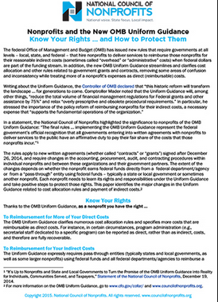
OMB Uniform Guidance:
From Promise to Reality
Advocacy Efforts to Protect, Clarify, and Fix
  Protecting Nonprofit Rights (a work in progress)
  Government audits (3 years later)
  State contracting review process
  Direct communications government officials
  Know Your Rights … and How to Protect Them
  What other ideas do you have?

Slide 21
OMB Uniform Guidance:
From Promise to Reality
Advocacy Efforts to Protect, Clarify, and Fix
Tools for Clarifying/Fixing the Uniform Guidance
  Engagement through West Virginia Nonprofit Association
    What isn’t clear in the Uniform Guidance?
    What are you hearing from Government
  Uniform Guidance Implementation Report Form
  Your Network’s Inputs
    National Task Force
    Ad Hoc Advisory Committee
  What other ideas do you have?

Slide 22

Beth Bowsky
Policy Specialist, Government-Nonprofit Contracting
bbowsky@councilofnonprofits.org
513-533-9031
David L. Thompson Vice President of Public Policy
dthompson@councilofnonprofits.org
202-962-0322
Questions?

